Slide 1
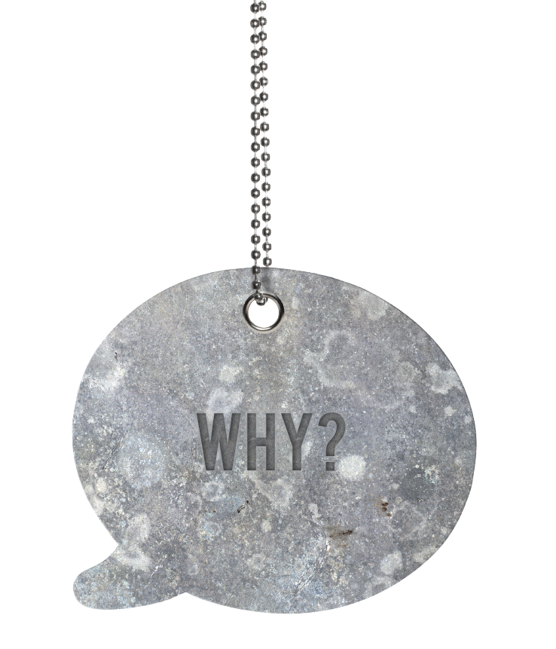

Slide 2
Inspired, happy, more profitable people…
©Purple Cubed 2014
www.purplecubed.com
Notes:
Why

Slide 3
Key issues for employers
Good no longer good enough
Customer service memorable customer experience
Multi everything workforce
Stakeholder / economic pressures
Joined up thinking
Culture and values
©Purple Cubed 2014
www.purplecubed.com
Notes:
Why

Slide 4
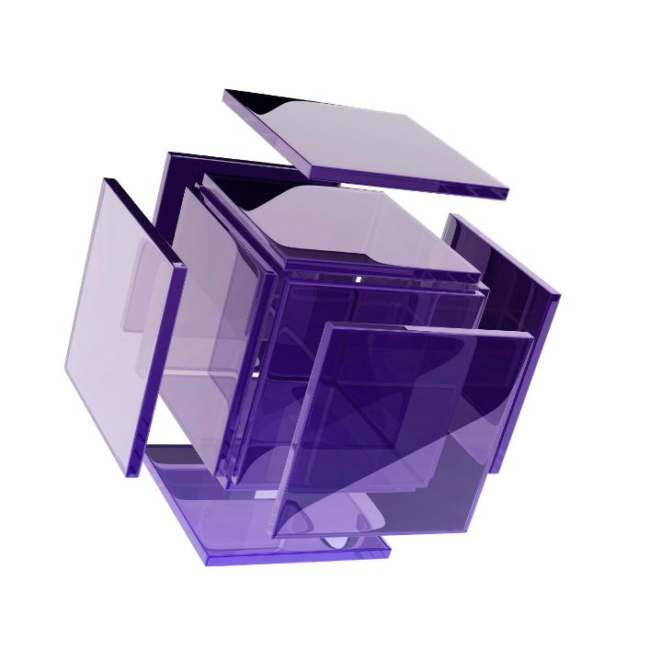
Employee engagement
19% - Engaged
61% - Potentials
20% - Actively disengaged
Actively disengaged has doubled since 2008 to 40% of the workforce
58,000+ respondents
34 countries
20 industries
Corporate Leadership Council –
Global EVP Survey 2008
©Purple Cubed 2014
www.purplecubed.com
Notes:
Why

Slide 5
And another one
23%
26%
15%
14%
Blessing White Research
22%
©Purple Cubed 2014
www.purplecubed.com
Notes:
Why

Slide 7
HAPPY?
©Purple Cubed 2014
www.purplecubed.com
Notes:
What

Slide 8
What people want
Challenge Progress Trust Freedom Fun
©Purple Cubed 2014
www.purplecubed.com
Notes:
What

Slide 9
BECOME A GREAT PLACE TO WORK
©Purple Cubed 2014
www.purplecubed.com
Notes:
What

Slide 11
©Purple Cubed 2014
www.purplecubed.com
Notes:
How

Slide 12
Leaders at all levels
Notes:
How

Slide 13
Generation theory
Baby Boomers
1945-1961
Generation X
1962-1981
Generation Y
1982-2000
Notes:
How

Slide 14
Baby Boomers | Gen X | Gen Y
Live to work | Work to live | Work to fund lifestyle
Long hours and dedication | Do the necessary and go home | Work life balance, bored easily
Motivated by prestige, perks, status | Motivated by change, freedom, respect, outputs | Motivated making a difference
Knowledge = Power | ‘Show me what you know’ | Generation ‘Why?”
Compliance, parent-child relationship with employer | Adult to adult relationships | Confidence to have adult to adult relationship
Know they’ve done a good job | Like regular feedback | Like immediate feedback
Make own decisions without consultation | Take direction and then get on with it | Need constant collaboration / direction
Respect structure and hierarchy | Have distain for authority and structure | Family values – require nurturing environment
Like being in control | Hate being micro-managed | Need help with problem solving, like to share
Want to lead | Self-reliant, cynical | Don’t want to lead
Resist change | Relish change | Flexibility
Value experience | Assert individuality | Experience irrelevant
Competitive and resilient | Want to fix Boomers’ ‘mistakes’ | Want to take on tough, meaningful jobs
Parents said “Just do it” | “Stand on your own two feet” | “You’re wonderful and brilliant at everything”
Kept opinions to themselves | Shared their opinions | Think you want to know their opinions
©Purple Cubed 2014
www.purplecubed.com
Notes:
How

Slide 16
If you do only three things:
Culture / values
Joined up talent management
Leadership at all levels
©Purple Cubed 2014
www.purplecubed.com
Notes:
What if

